Slide 1
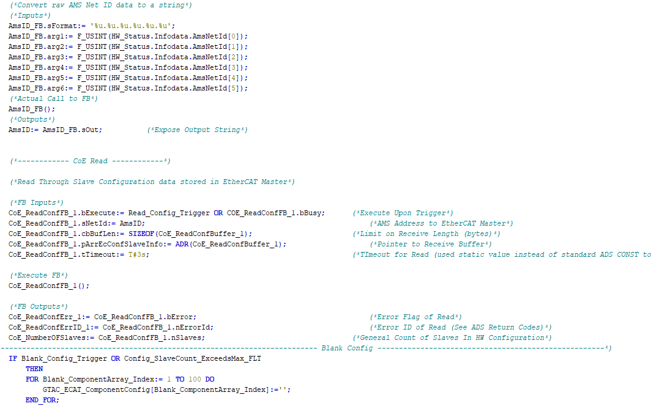

Internal Training:
PostgreSQL Server Extension

Slide 2
Prerequisites
This document is intended to help, in a self-directed manner, navigate through our PostgreSQL Server Extension package built for our TcHmi based UI and assumes the following:
You have setup your local PC environment as per the IC Setup Guide contained in the SSCC610 machine package with:
XAE 4024.55 (in addition to .22)
TcHmi TE2000 (TcHmi Engineering)
TcHmi TF2000 (TcHmi Server)
Postgres / pgAdmin (Database / Database administrative tool)
Successfully deployed FW level SSCC610 locally on the above environment
Completion of all previous GTAC Internal Controls Training
Visual Studio 2022 is installed on your PC (check with your manager and I.T. to ensure VS 2022 is applicable / allowable in terms of Microsoft licensing agreements)

Slide 3
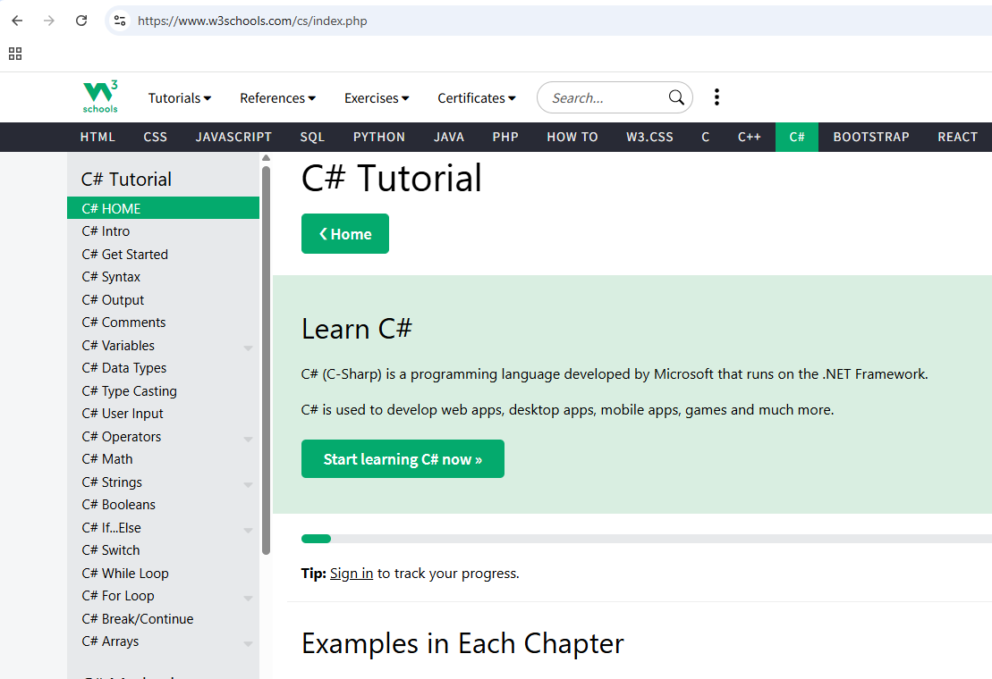
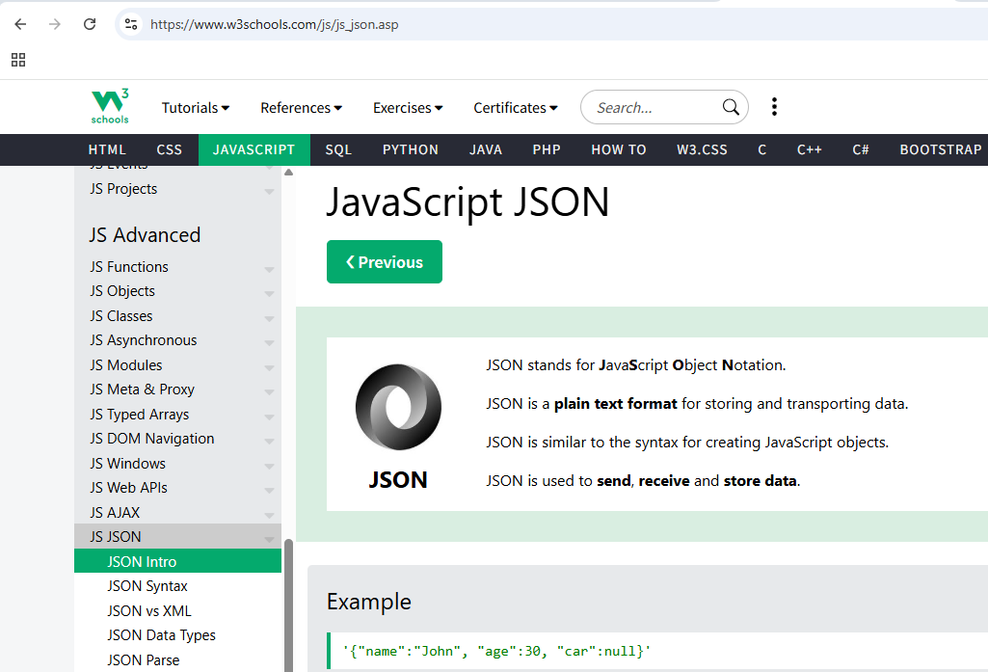
Prerequisites
Our Server Extension is built primarily using the C# Language
You will also see use of JSON files for general configuration
W3 schools offers great tutorials for both C# and JSON if you are unfamiliar

Slide 4

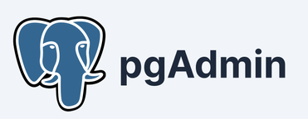
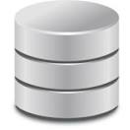


General Topology
Postgres
Database
Server
pgAdmin is an
administrative tool
Used to configure the
Postgres Database
GTAC TcHmi Machine UI (with GTAC PostgreSQL Server Extension)
Administrative
Commands
Bi-Directional
Data

Slide 5
General Topology
Postgres Database
Server
GTAC PostgreSQL
Server Extension (SE)
GTAC TcHmi
Machine UI
Bi-Directional
Data
Bi-Directional
Data

Slide 6
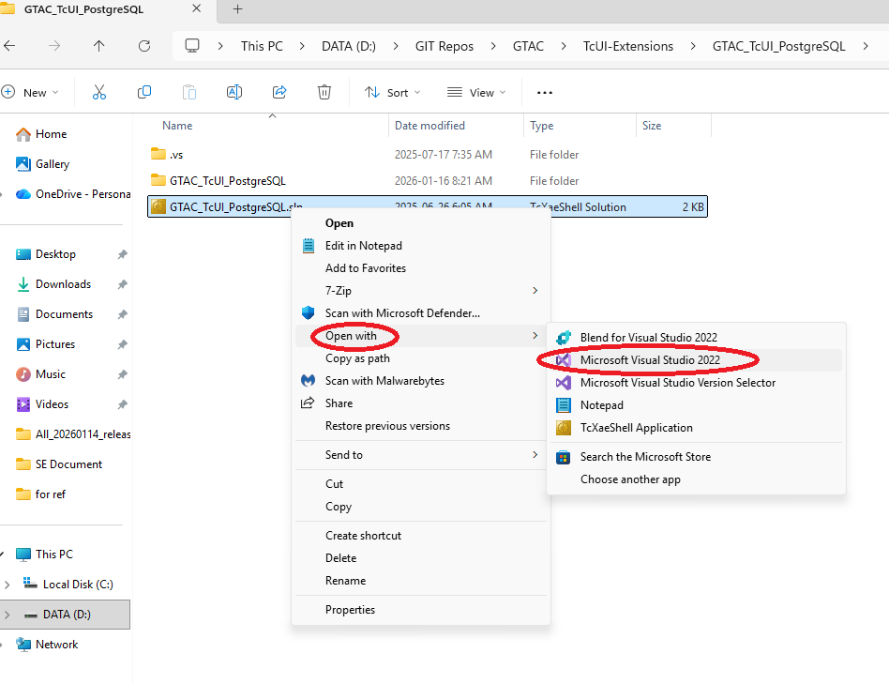
General Layout of the SE
The GTAC PostgreSQL Server Extension (SE)
can be opened, edited and packaged using Visual Studio 2022
(version 17.14.25 used in all the following examples)

Slide 7
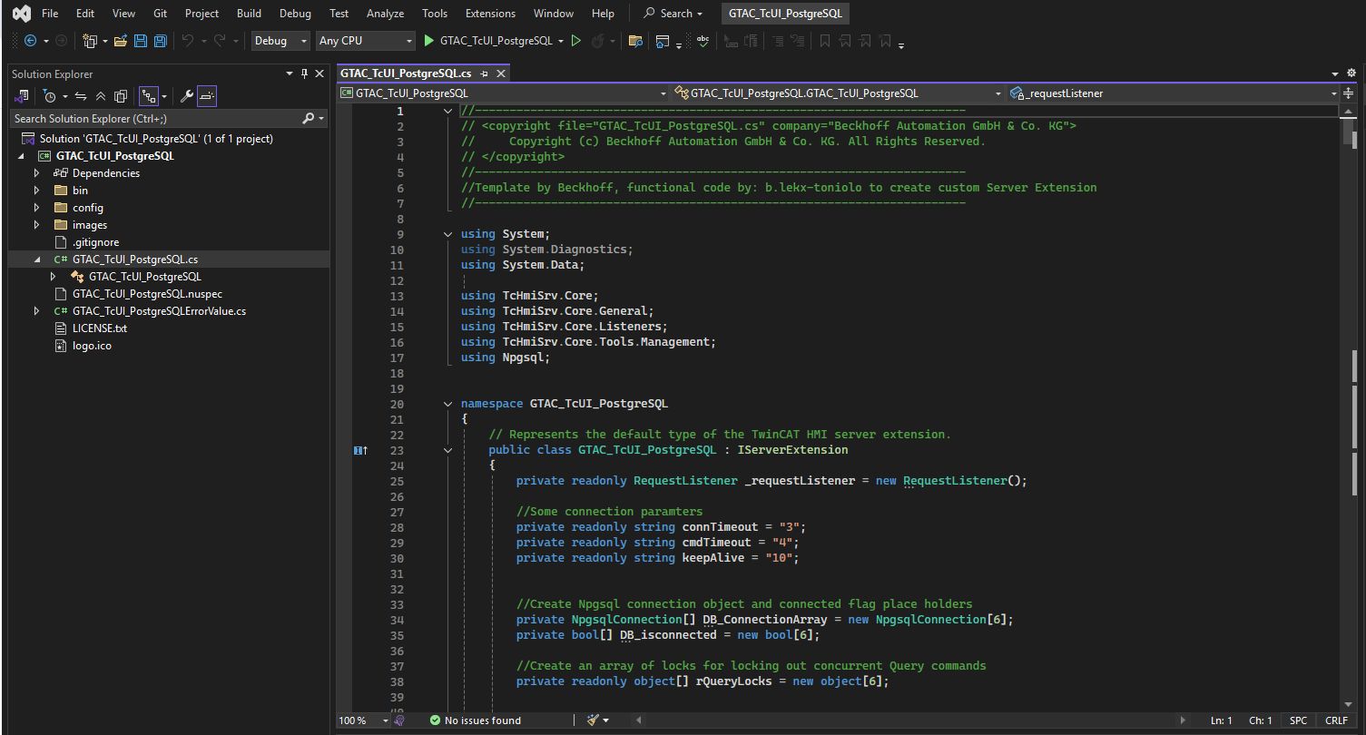
General Layout of the SE
Here we see the GTAC PostgreSQL Server
Extension, opened in VS 2022
(the GTAC_TcUI_PostgreSQL.cs file opened in the example below)

Slide 8
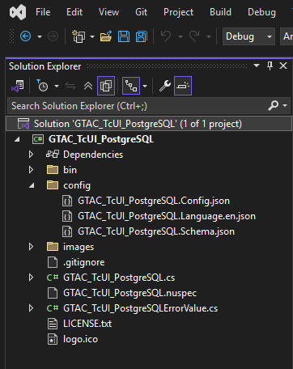
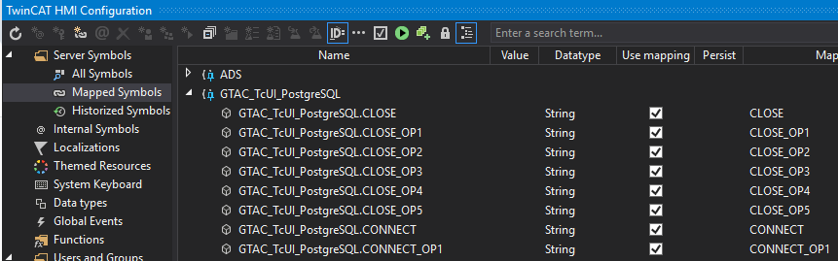
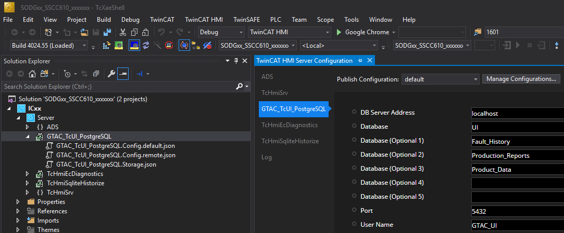
File Breakdown
Let’s have a look at some of the files contained in the Package:
GTAC_TcUI_PostgreSQL.config.json -> A JSON file used to describe the symbol interface that will be used for our TcHmi UI and the PostgreSQL SE to communicate thru. Symbols described in this file will show up in the TcHmi project similar to PLC symbols (see right)
GTAC_TcUI_PostgreSQL.Schema.json -> This file describes the SE’s configuration interface that will show up in XAE when you click on the SE. This allows the TcHmi developer to customize aspects of the SE such as the database server location and port etc. (see right)
GTAC_TcUI_PostgreSQL.Language.json -> In this file we can see English language locales for the configuration points set out in the GTAC_TcUI_PostgreSQL.Schema.json file (see right)
GTAC_TcUI_PostgreSQL.cs -> This is the source code file. The bulk of the functional code is contained in this file. This is generally where you will spend most of your time.
GTAC_TcUI_PostgreSQL.csproj -> This is an XML based file that contains meta data about your project, including how resultant build files, dependencies and other files get packed into a NuGet package. The NuGet package is what is brought into our TcHMI UI project. NOTE: using the csproj file to list out NuGet packing directives is a replacement to the older nuspec method where these directives were held in a separate .nusepc file

Slide 9
GTAC_TcUI_PostgreSQL.cs
Since the bulk of the functional code is contained
in the GTAC_TcUI_PostgreSQL.cs file, lets have a closer look!
The file can be primarily broken down into three parts:
Using Directives
Class Declaration / Definition
Application Specific Methods
The OnRequest method
Please note that all the methods in 3 and 4 are contained in the
GTAC_TcUI_PostgreSQL class (2).

Slide 10
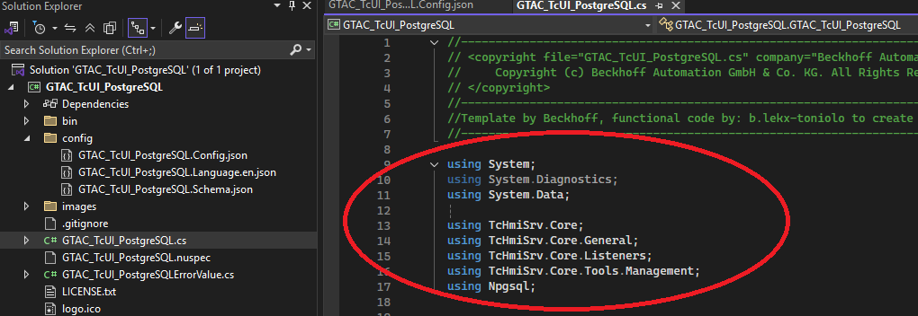
GTAC_TcUI_PostgreSQL.cs
1. Using Directives
The “Using Directives” of the GTAC_TcUI_PostgreSQL.cs file lists out other namespaces (think dependencies) we will leverage in our code

Slide 11
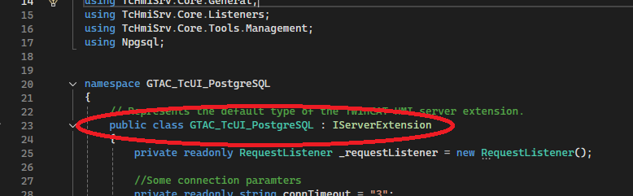
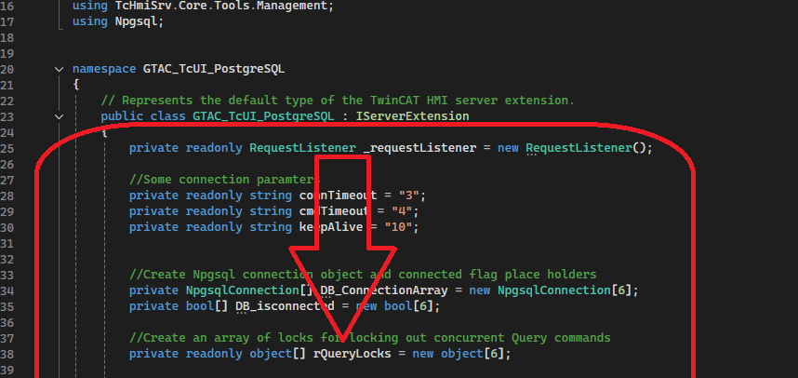
GTAC_TcUI_PostgreSQL.cs
2. Class Declaration / Definition
The term “Class” may be new to you. You can think of a class like an FB in TwinCAT structured text. A class contains variables, methods (IE actions) and functional code just like an FB.
In our case, as is typical in C#, we declare and define the class in the same block of code.
This is the class declaration ->
Technically, everything else in the class
(which in our case is the rest of the
file contents) is the class definition ->

Slide 12
GTAC_TcUI_PostgreSQL.cs
3. Application Specific Methods
The Application Specific Methods are the real nuts and bolts of how our server extension works. They are the functional code that end up being called when the TcHmi UI accesses a Server Extension symbol.
The full list of methods is too large for the scope of this document. You are encouraged to study the code in depth to gain a good understanding of how each method works.
Some methods of particular interest are: “Connect_Base”, “Read_Base”, “Write_Base” where the heavy lifting is done.
Please note that some typical C# best practices were not used during the development of this SE in such cases where code style more typical of what you may have seen in TwinCAT were used. This was done to help the migration from one environment to the other.

Slide 13
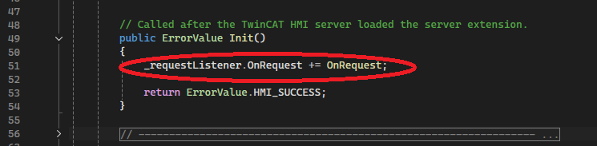
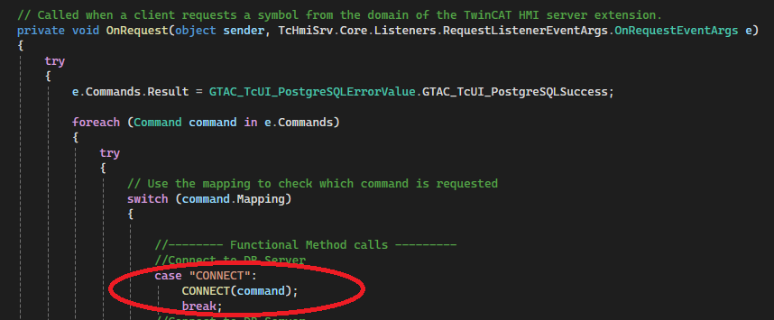
GTAC_TcUI_PostgreSQL.cs
4. OnRequest Method
The OnRequest Method is the last method in the GTAC_TcUI_PostgreSQL class. It is a “callback” method registered against the Server Extensions request listener. So, when the TcHmi UI makes a request to the server extension by accessing one of the Server Extension symbols, this OnRequest method is executed. The symbol that was accessed in the request by TcHmi contains a “command” object. The command object contains a mapping string that identifies which symbol was accessed.
Here is where we register the OnRequest method to the request listener ->
Further to above, an example; if the “CONNECT” symbol is accessed in the machine’s TcHmi UI, the request listener detects this event and passes the associated command object — which includes the command mapping string (in this case, "CONNECT") — to the server extension ->
Inside the server extension, the OnRequest method processes the incoming command by checking the command’s mapping string in a switch statement.
When the "CONNECT" mapping is detected, the OnRequest method calls the corresponding CONNECT method and passes the command object to it. The CONNECT method then performs the necessary operations and uses the command object to send data or results back to the TcHmi client ->

Slide 14
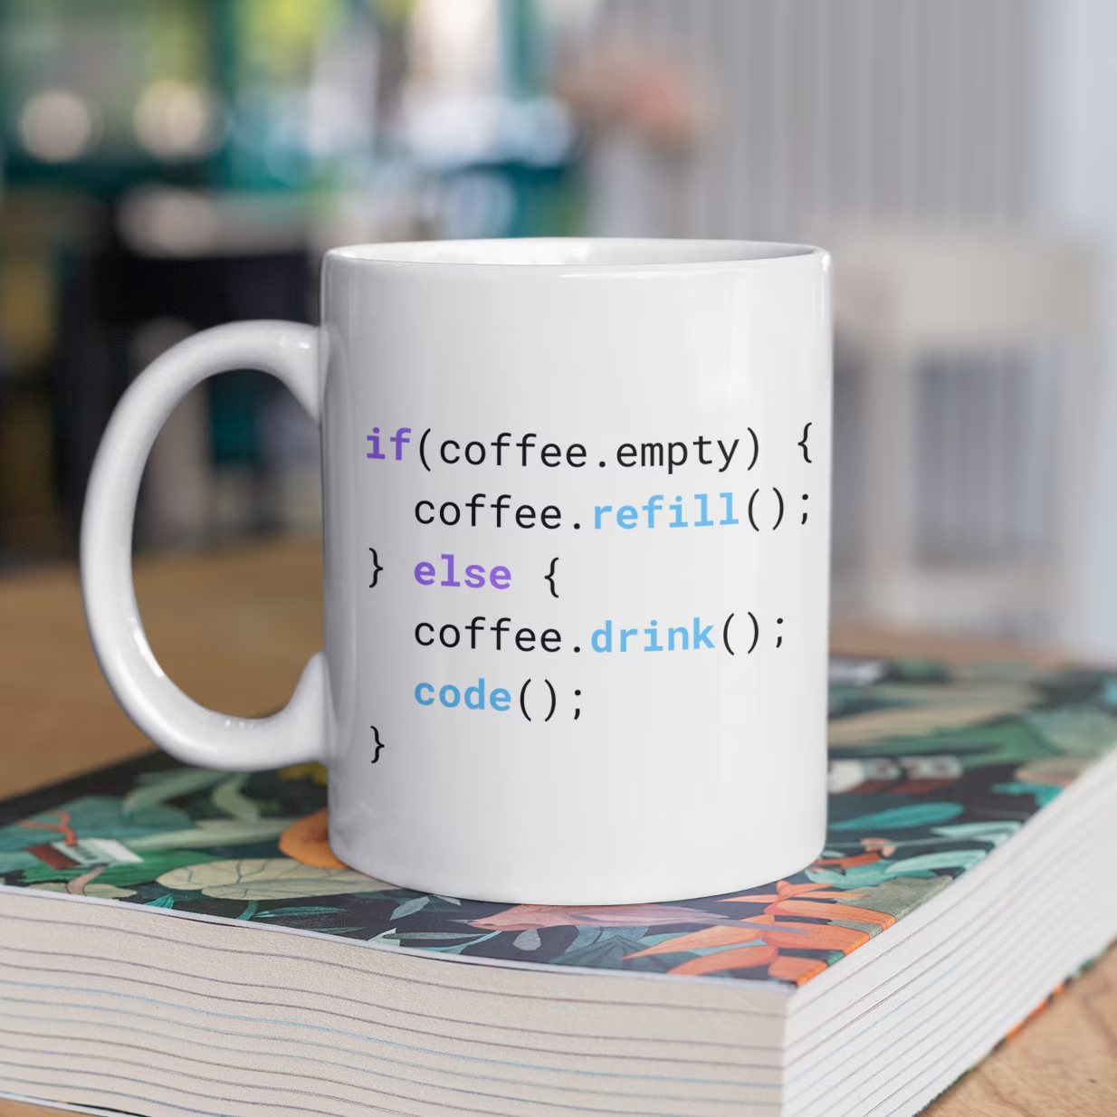

Edit, Build, Pack
So, you’ve decided to make some edits to our PostgreSQL package! Be it a new feature, fixing a bug or whatever, the routine is all the same. First you will perform your edits, next you will build the code and check for build errors, last you will pack the product into a NuGet package. Let’s get started…

Slide 15
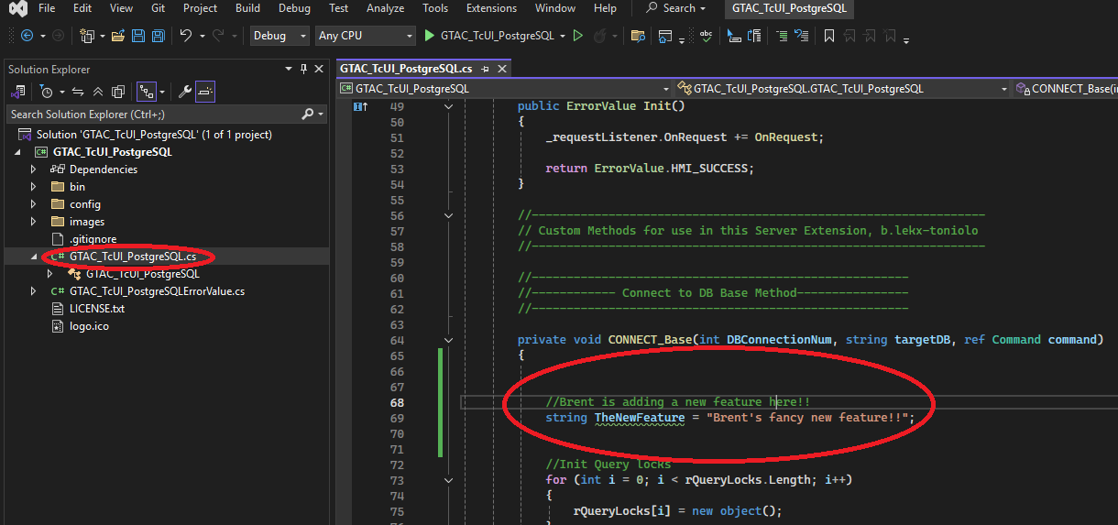
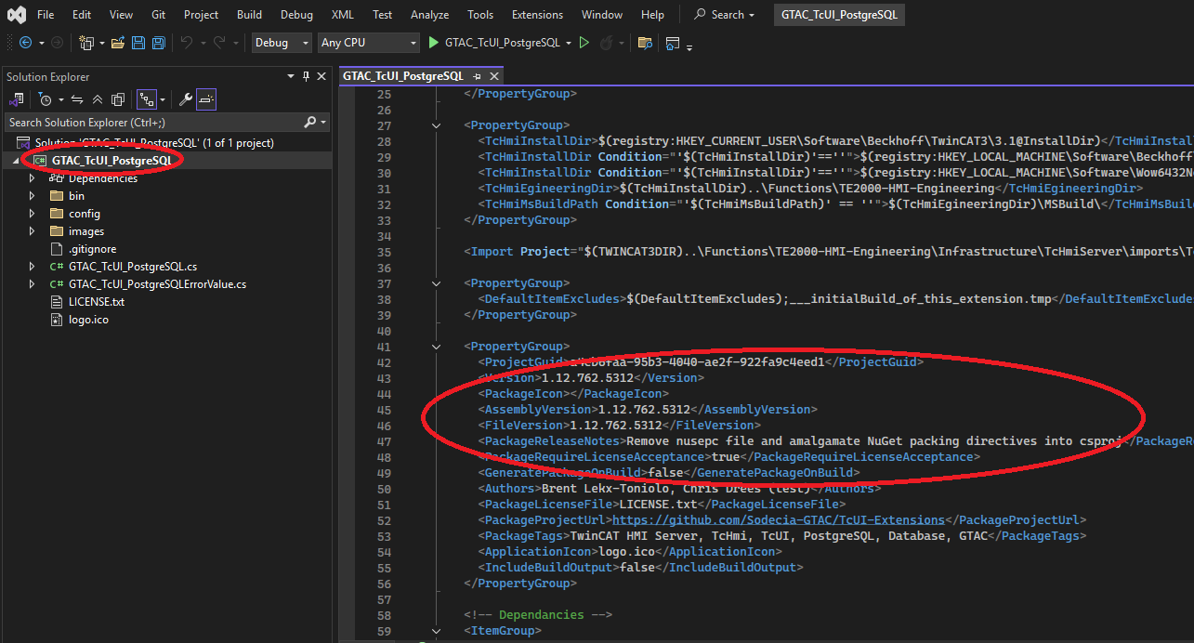
Edit, Build, Pack
First, begin by performing your edits. Remember to take into account functional criteria, style best practices, commenting etc.
We will not go into depth on this topic as it is a topic unto itself. Most of your editing will likely be done in the GTAC_TcUI_PostgreSQL.cs file.
Also, remember to edit the version information tags and release notes in the csproj file as well.

Slide 16
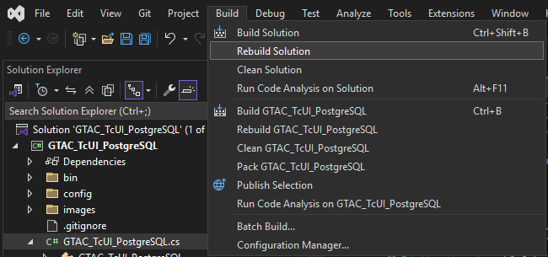
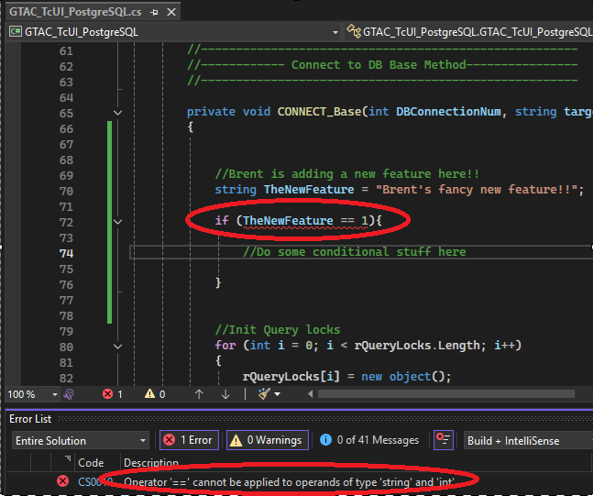
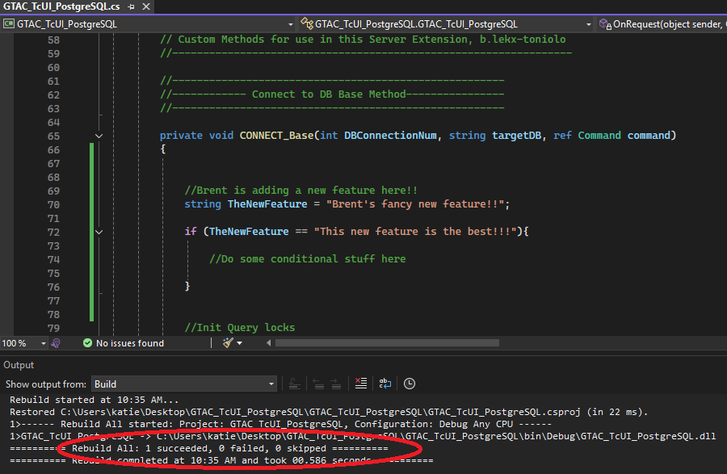
Edit, Build, Pack
Next, as you complete with your edits, build your code and check for build errors, correct as required.

Slide 17

Edit, Build, Pack
Last, Packing.
Your editing is done, built successfully and you’re happy with it. So, now how do we get the newly edited Server Extension into our TcHmi UI project? We use NuGet to create a package (or nupkg)!
A NuGet package is a highly portable method of creating one file that contains all your compiled code, dependencies and other files that are required for your product to run.

Slide 18
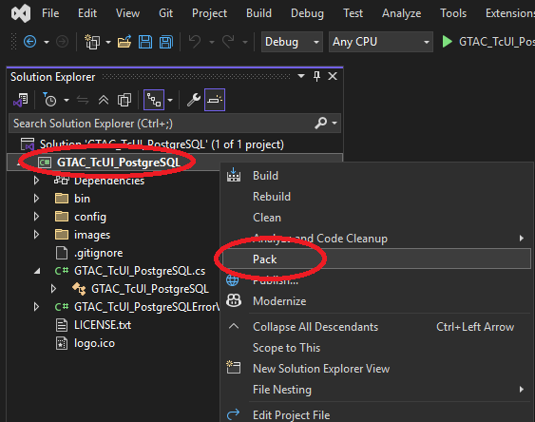
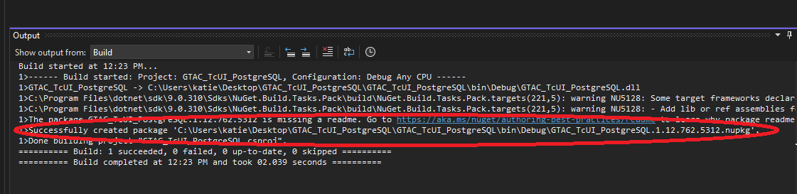
Edit, Build, Pack
Creating the NuGet package is easy. The directives of how the package will be laid out are stored in the csproj file. Nothing needs to be modified with these directives except the version and release notes (as previously mentioned). You simply right click the csproj file and select “Pack”, the Nuget Package manager will take over.
The output window will show you the status of the pack routine.
Please note the version of the package is integrated into the name of the package file (the .nupkg file). This is why it’s important to ensure the version information is updated.

Slide 19
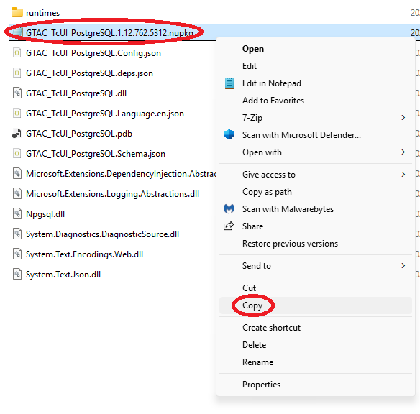
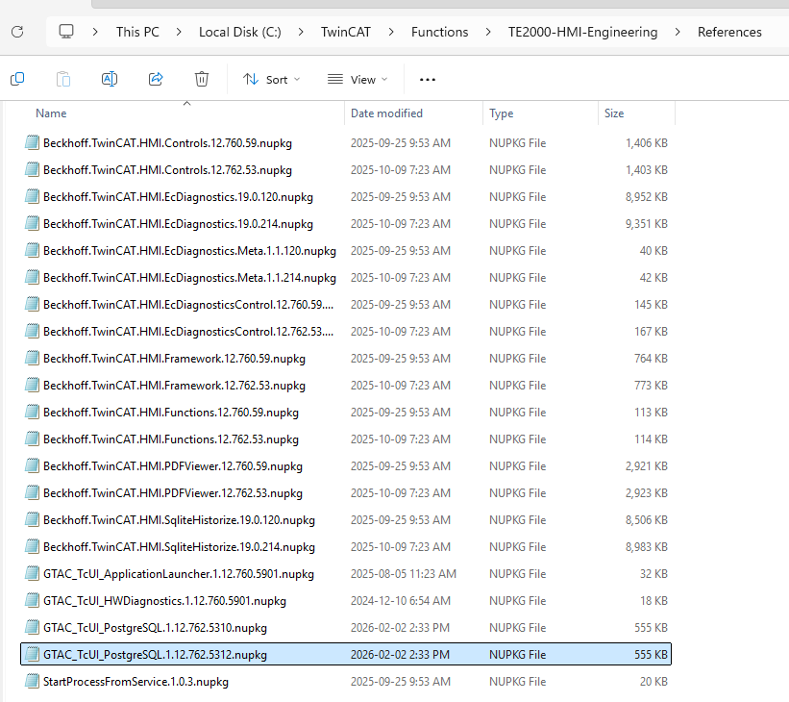
Edit, Build, Pack
In the previous slide, we packaged up our SE, this created a NuGet package (nupkg file). Note the location it stored this file in.
Navigate to this location and grab a copy of the nupkg file.
To be able to integrate the package into your TcHMI UI project, you will add the new nupkg file to your “TwinCat Hmi Customer” location, by default this location is at:
C:\TwinCAT\Functions\TE2000-HMI Engineering\References
Paste a copy of the nupkg file into this location, you can lave the older version of the nupkg file.

Slide 20
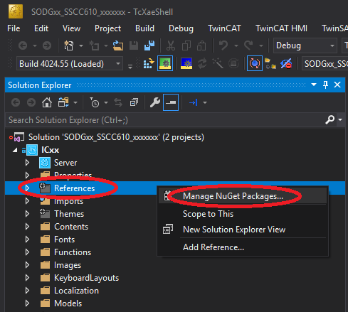
Update TcHmi
Finally, we can bring the updated NuGet package into the TcHmi UI project. Start by opening the TcHmi UI project in XAE.
In the Solution Explorer Window, navigate to References, right click it and then select “Manage NuGet Packages”

Slide 21
Update TcHmi
Finally, we can bring the updated NuGet package into the TcHmi UI project. Start by opening the TcHmi UI project in XAE.
In the Solution Explorer Window, navigate to References, right click it and then select “Manage NuGet Packages”

Slide 22
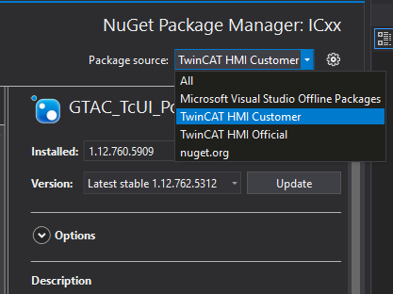
Update TcHmi
Once the NuGet Package Manager opens, be sure the Package Source is set to “TwinCAT HMI Customer”, this will point XAE to the location you previously added the new nupkg file to.

Slide 23
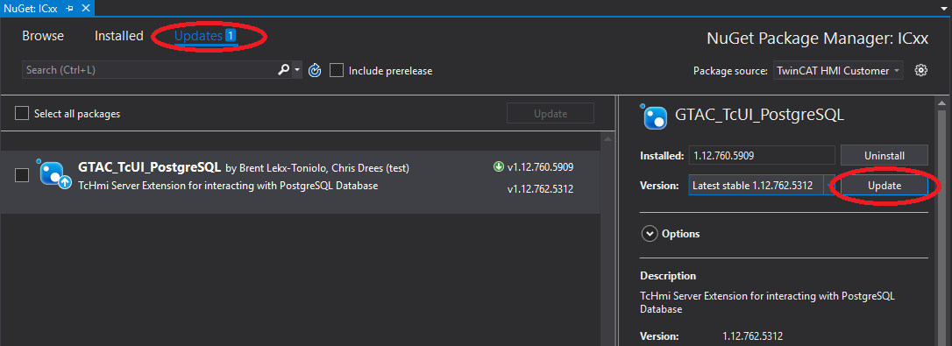
Update TcHmi
Now click the Updates Tab, you should see your newly updated package in the window below.
Confirm the version is correct then hit update.

Slide 24
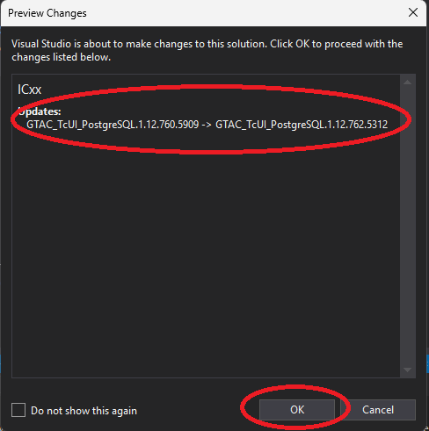
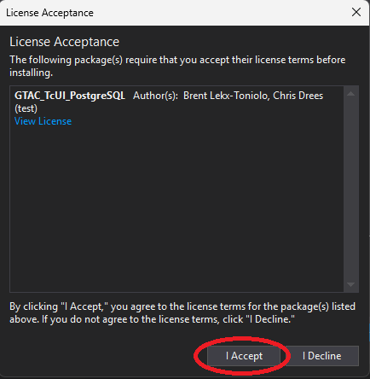
Update TcHmi
Review the Updates and click enter if all the information looks ok.
Then Accept the license agreement.
The Update process will begin…..

Slide 25
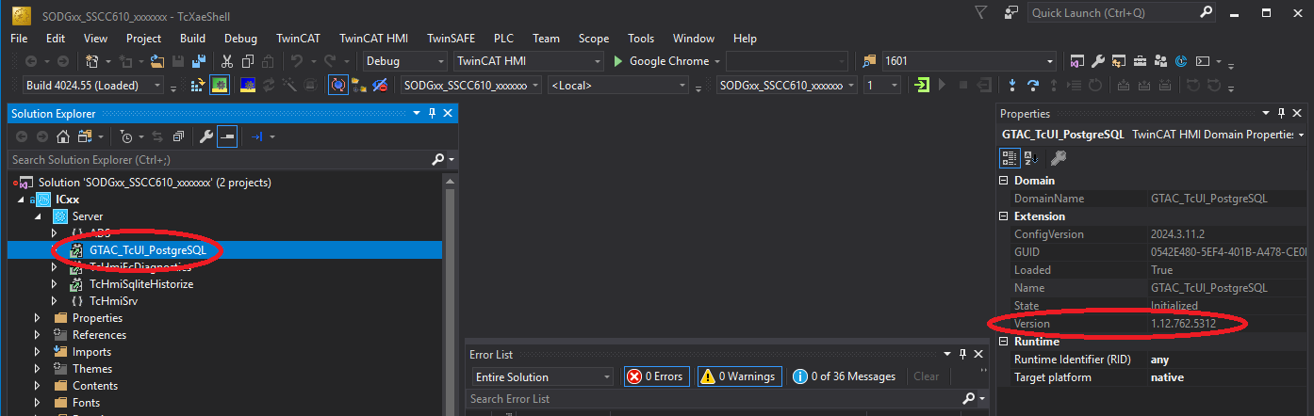
Update TcHmi
Once the update is complete, go ahead and close down the NuGet Package manager. Under “Server”, find the GTAC_TcUI_PostgreSQL SE and ensure it is green (it may be red for a bit while things settle). Also confirm the Version is as you’re expecting.

Slide 26
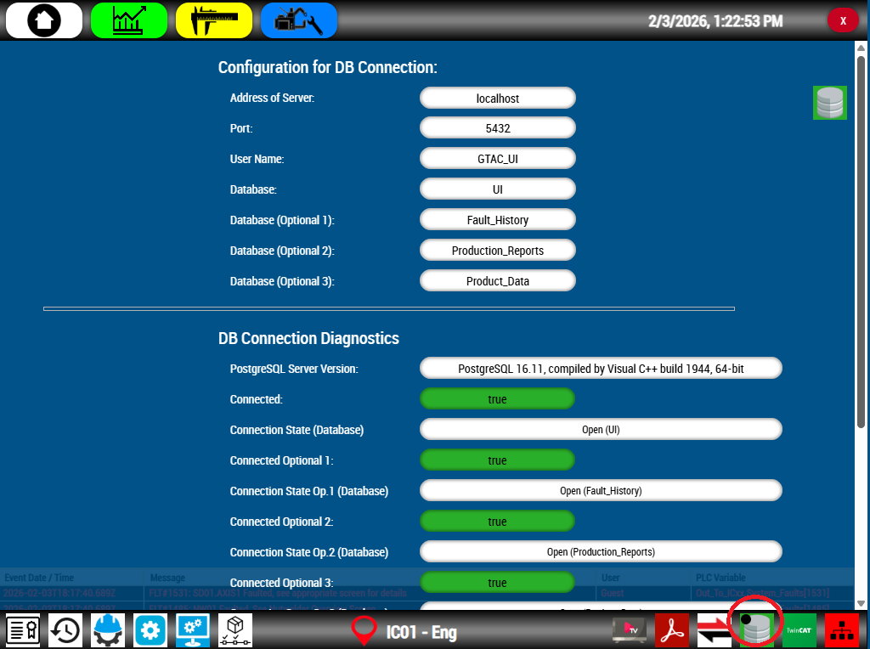
Update TcHmi
At this point you may Build and Publish your TcHmi UI project as normal and then test your changes.
It’s always a good idea to check the DB Screen to ensure your changes did not break existing functionality.
Have fun!

Slide 27

Thanks for your time

